Slide 1
BOOK SALES ANALYSIS
Pavlos Varsamis
Paschalis Tsiakiris
Kyriakos Papadopoulos

Slide 2
CONTENTS
Historic Analysis
Best Sellers
Popular Genres
Trends Over Time
Summary

Slide 3
BEST SELLERS
Our analysis unveils the underlying factors propelling these books to best-seller status, offering insights into what resonates with audiences and what sets these literary gems apart.

Slide 4
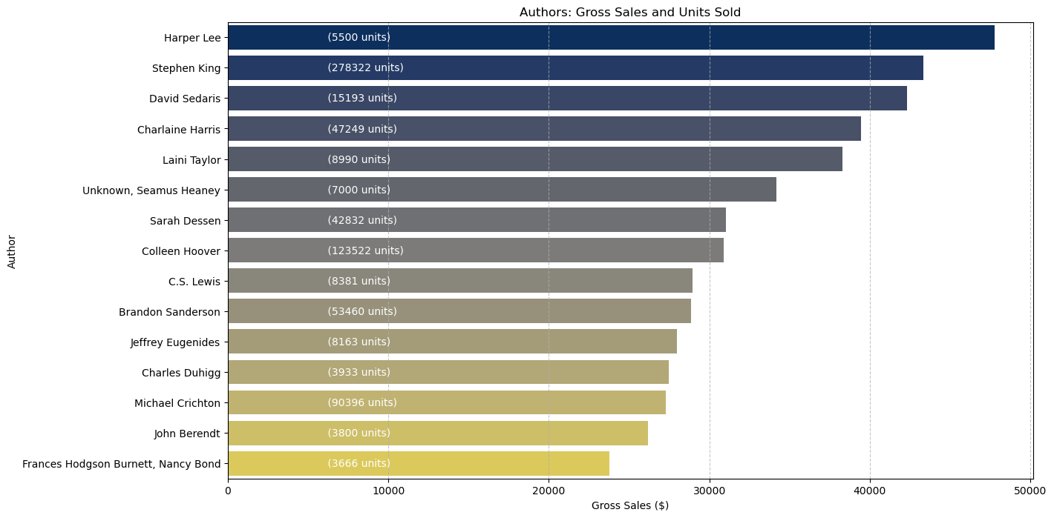
Best-Selling Authors (Total units sold, Total gross sales)

Slide 5
POPULAR GENRES
By dissecting reader preferences and consumption patterns, we unravel the allure of each genre and discern the underlying currents driving their popularity.

Slide 6
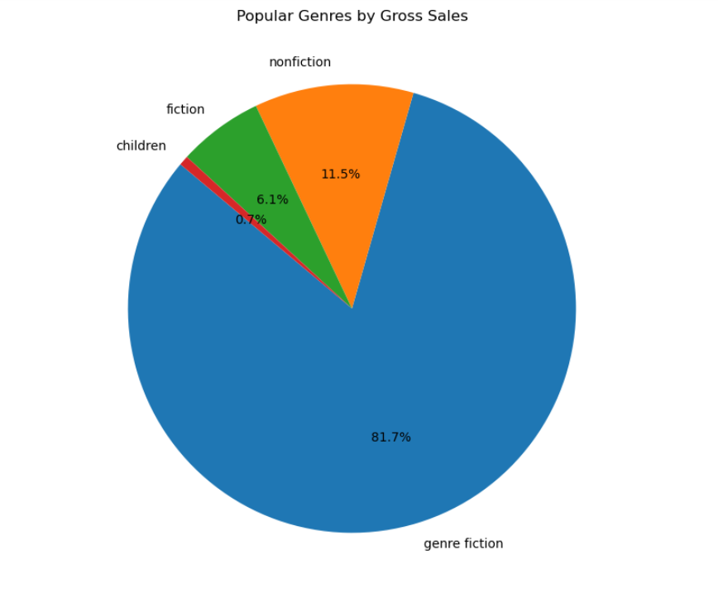
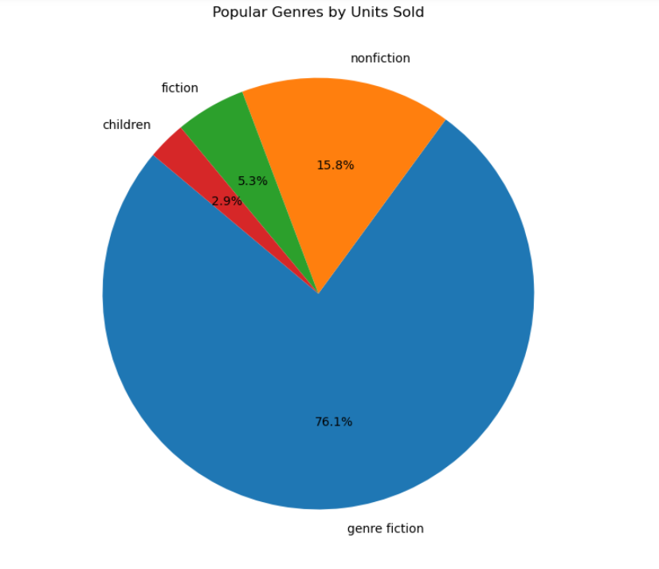
Most Popular Genres by Gross Sales vs Units Sold

Slide 7
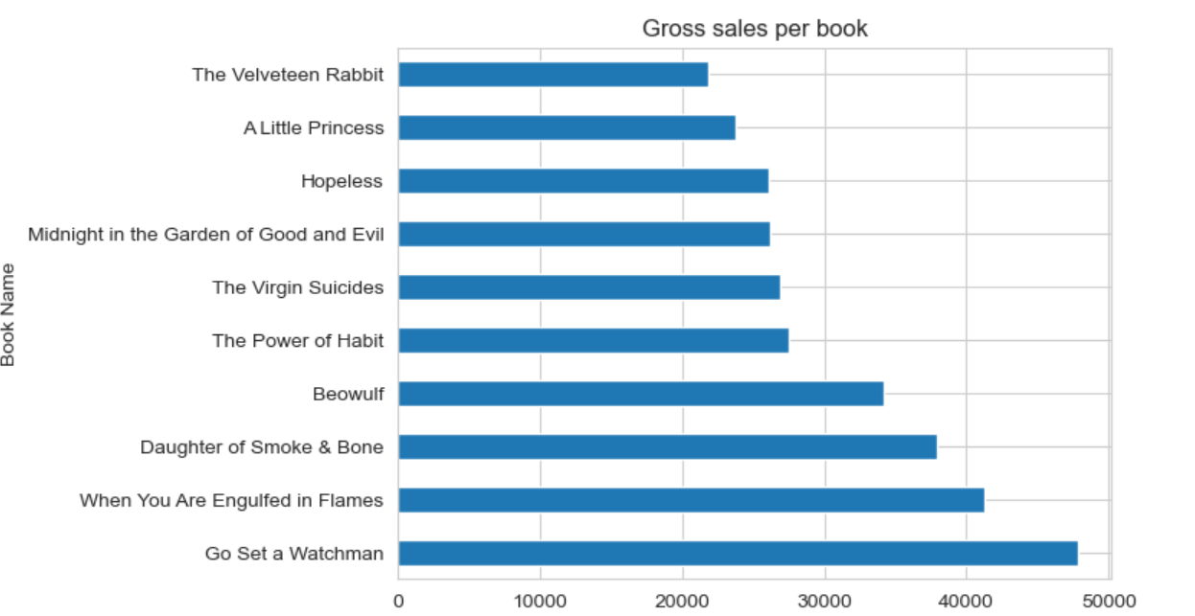
Top 10 books with the most gross sales

Slide 8
TRENDS
Delve into the captivating realm of book sales analysis as we uncover the secrets behind best-selling titles, explore the allure of popular genres, and trace the historical trends shaping readers' preferences over time.

Slide 9
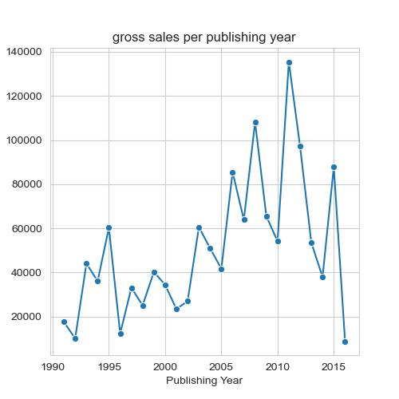
Gross sales per publishing year from 1990 to 2016

Slide 10
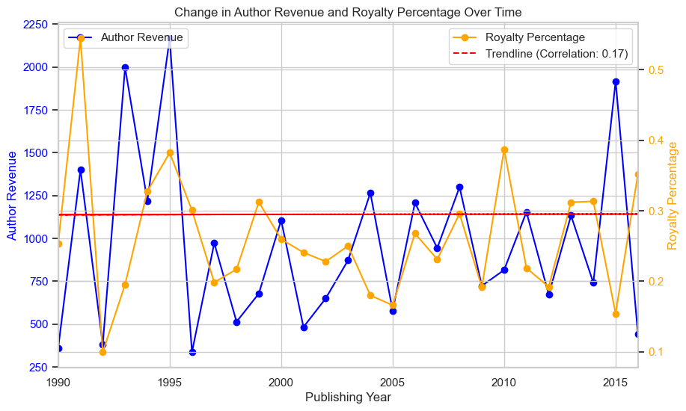
Effect of royalty percentage change on author revenue

Slide 11
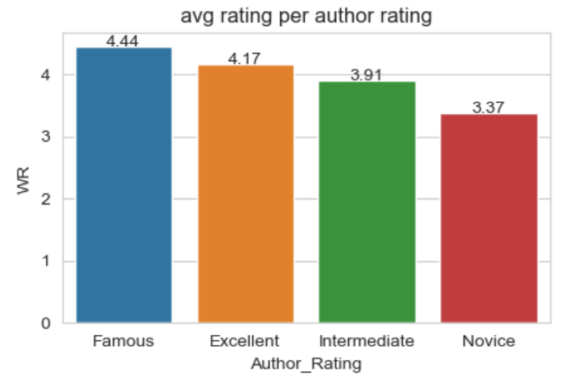
Average rating per author rating

Slide 12
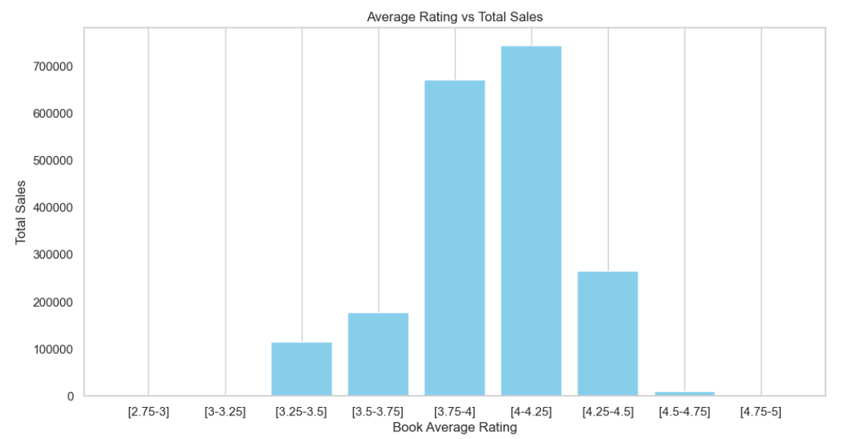

Slide 13
SUMMARY

Slide 14
THANK YOU

